Slide 1
Building Projects using Microcontrollers

Slide 2
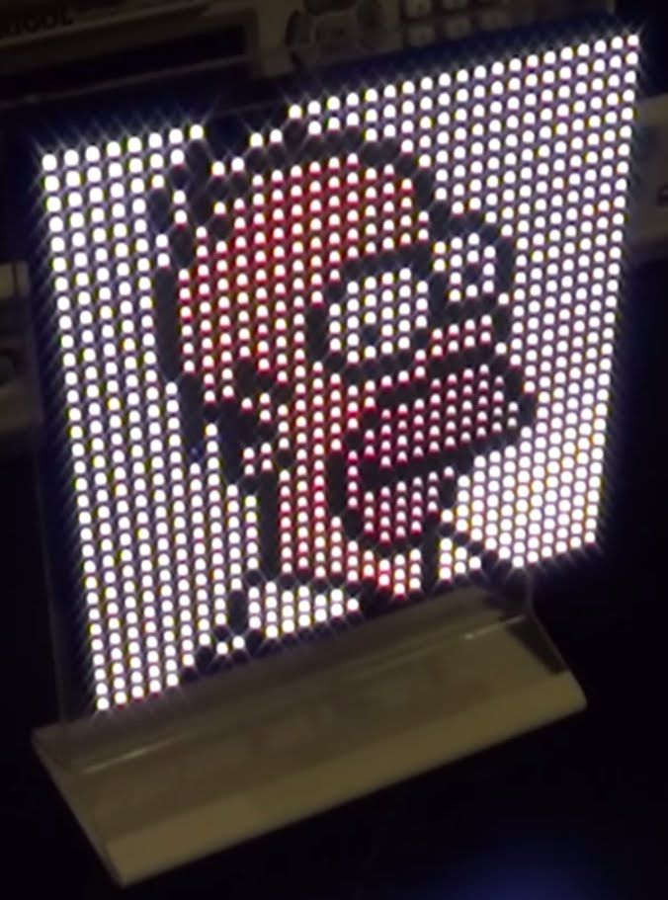
MCU with a LED Matrix Display

Slide 3
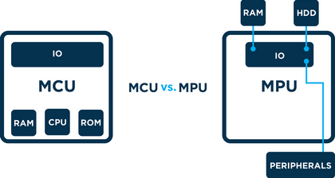
Microprocessors vs Microcontrollers

Slide 4
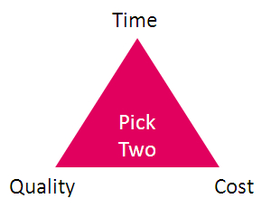
The Tradeoff to Selecting the Right MCU

Slide 5
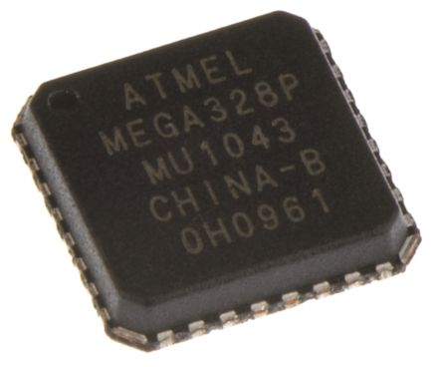
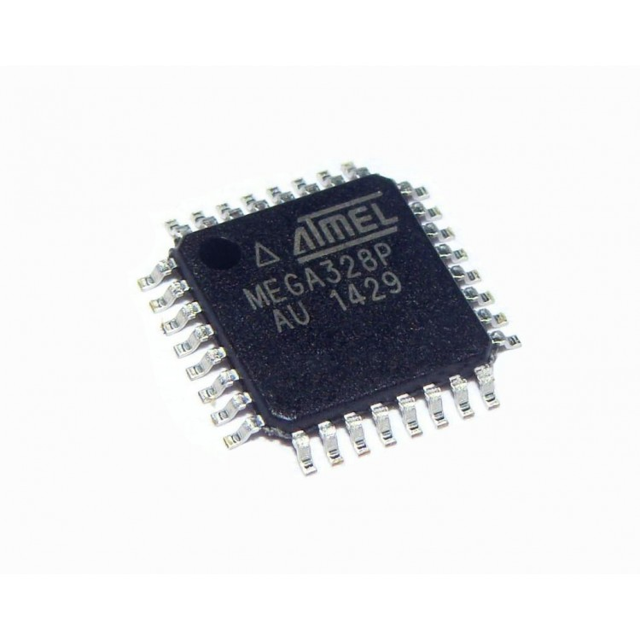
ATMEGA328P:

Slide 6
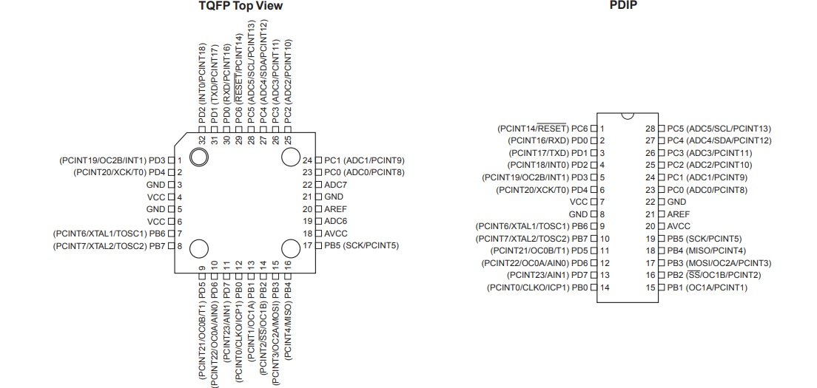
ATMEGA328P:

Slide 7
Minimal Operational Requirements of a Microcontroller
Power Supply
Clock
Hardware Reset
Programming Interface
User Interface

Slide 8
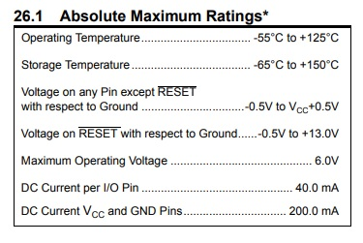
Power Supply
Estimate the total power required.

Slide 9
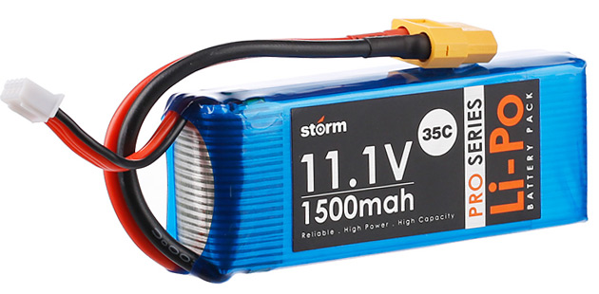
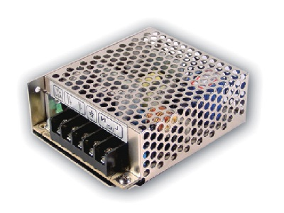
Power Supply
Batteries and Regulated Supplies

Slide 10
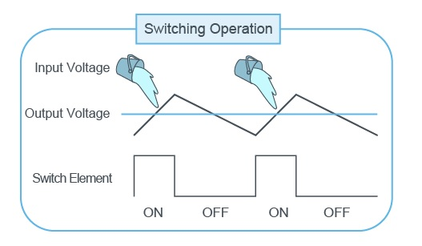
Power Supply
Voltage Regulators: Linear vs Switching Type

Slide 11
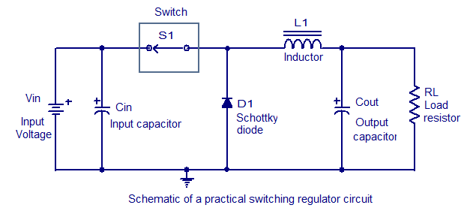
Power Supply
Power Supply

Slide 12
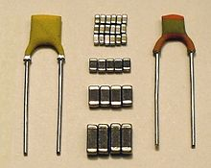
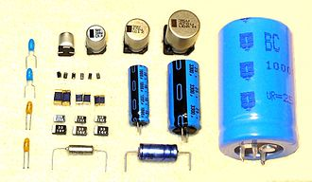
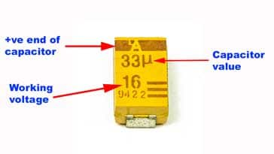
Capacitor Package Selection
Choices: Ceramic vs Electrolytic vs Tantalum

Slide 13
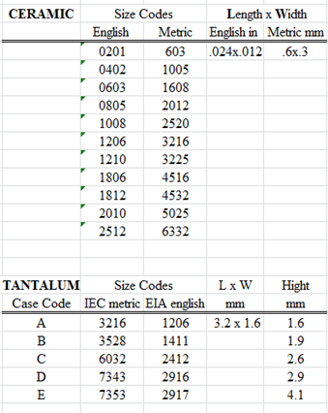
Capacitor Package Selection

Slide 14
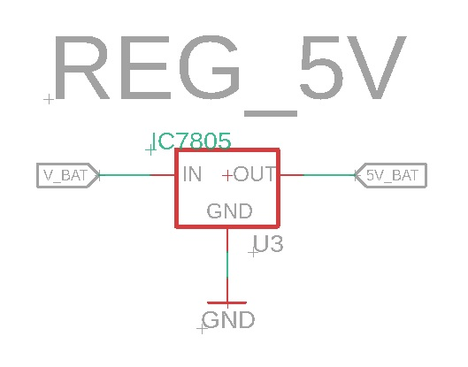
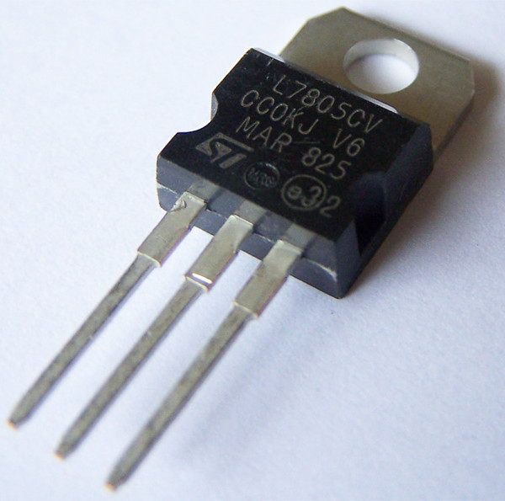
Power Supply
IC 7805

Slide 15
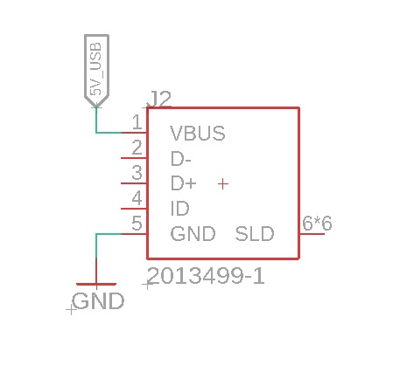
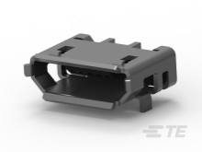
Power Supply

Slide 16
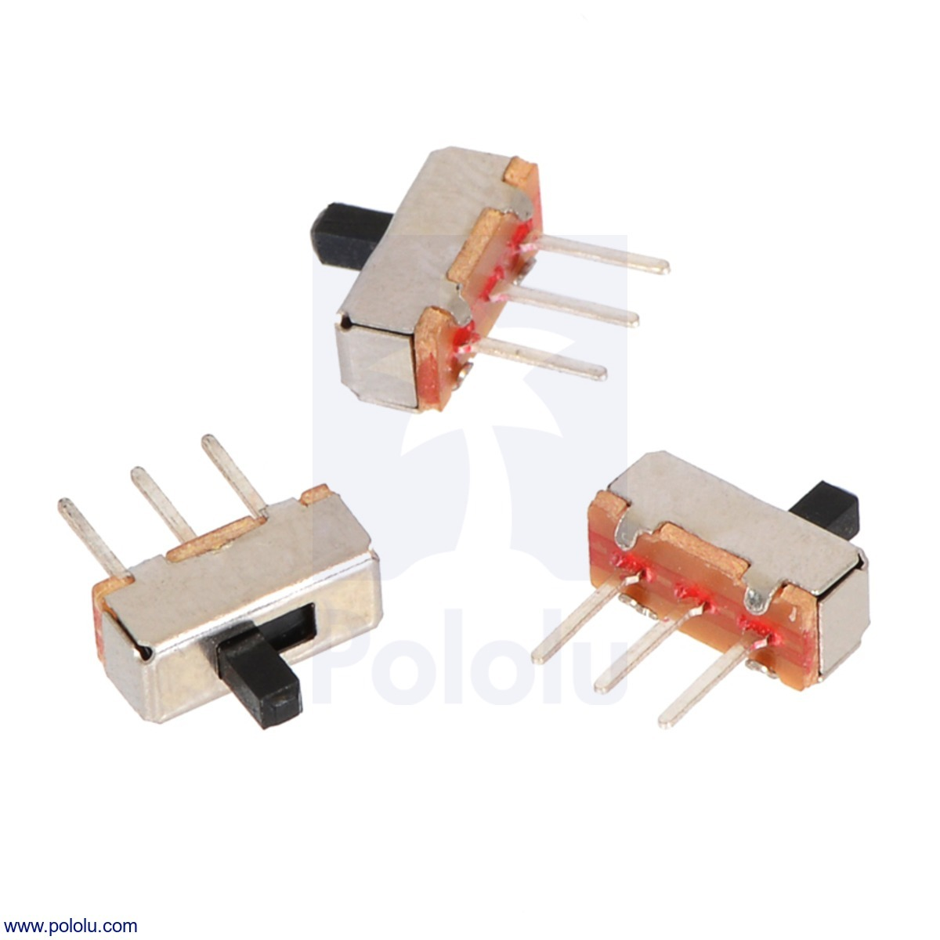
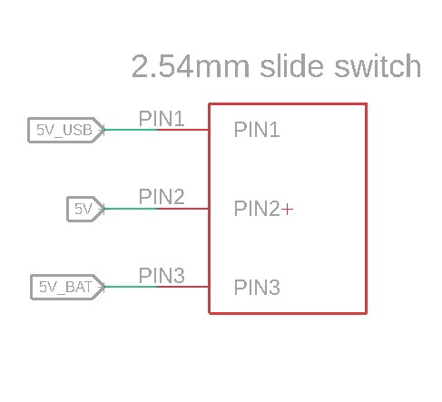
Power Supply
Switching between different sources

Slide 17
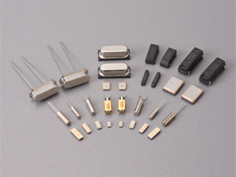
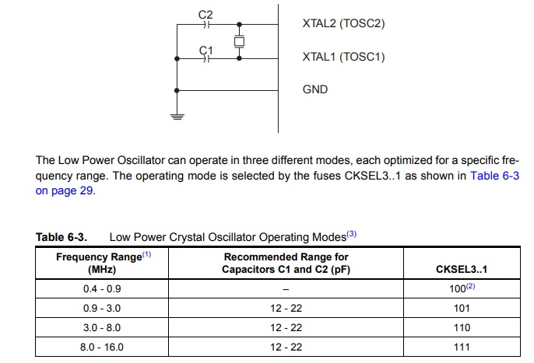
Clock
Crystal Oscillator

Slide 18
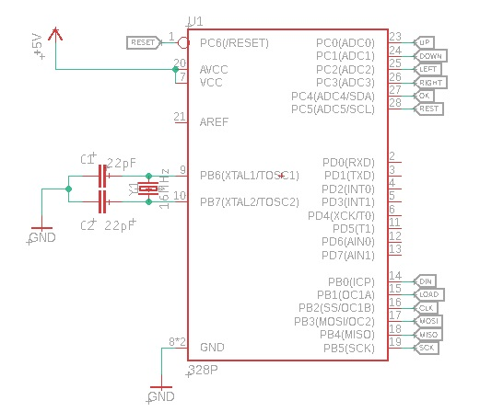
Clock
Crystal Oscillator

Slide 19
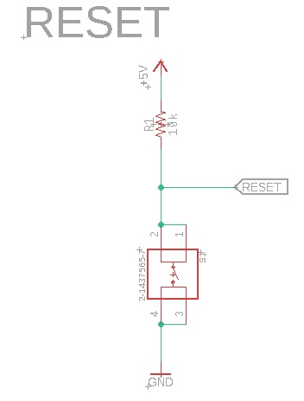
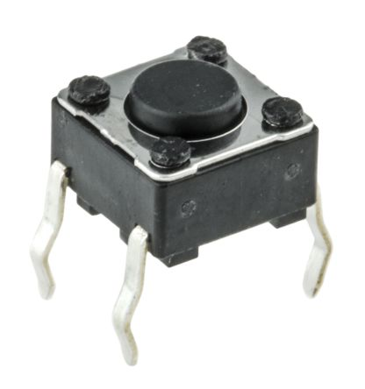
Reset
Atmega328p resets when a low signal is applied to the RESET pin for more than one clock cycle

Slide 20
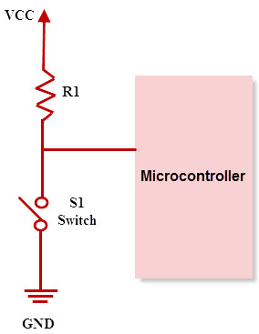
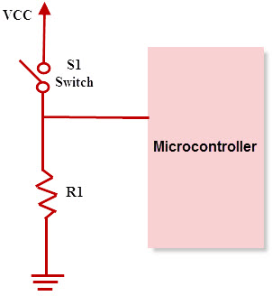
Pull UP/DOWN

Slide 21
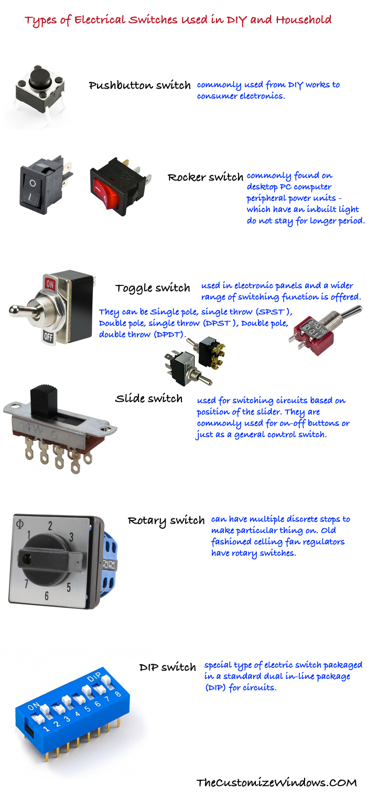
Types of Switches

Slide 22
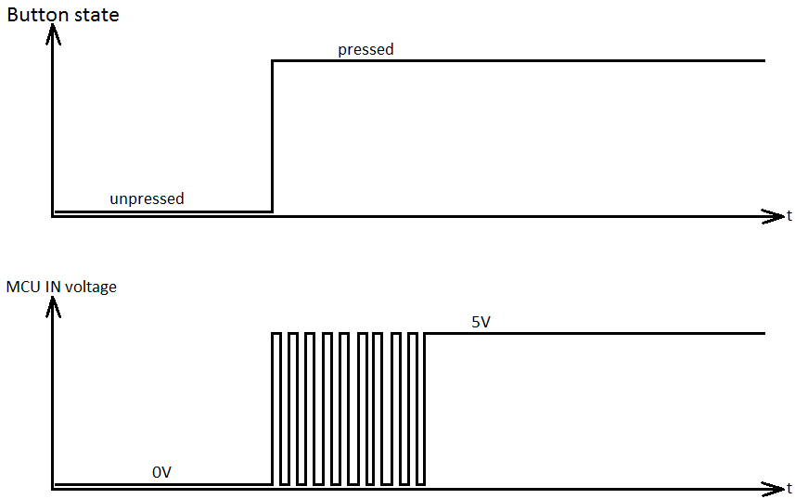
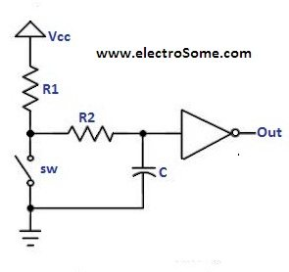
Switch Debouncing

Slide 23
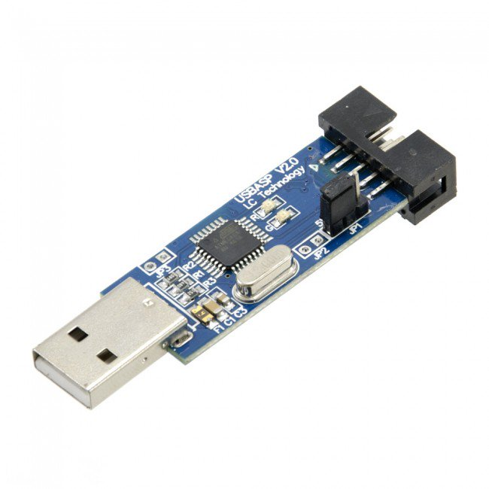
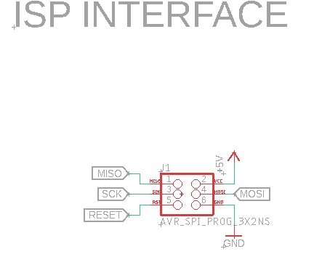
Programming Interface

Slide 24
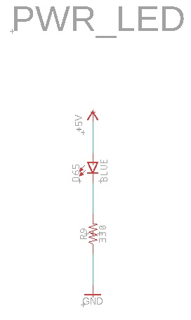
User Interface

Slide 25
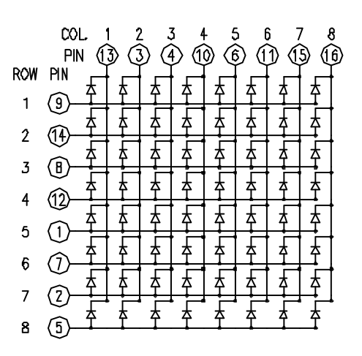
LED MATRIX CONSTRUCTION

Slide 26
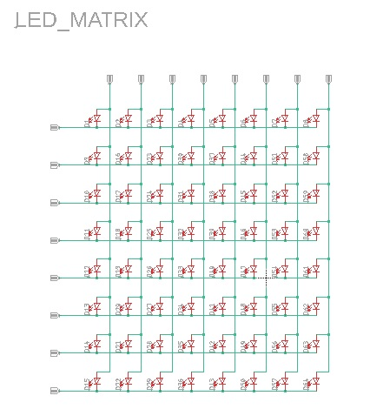
LED MATRIX CONSTRUCTION

Slide 27
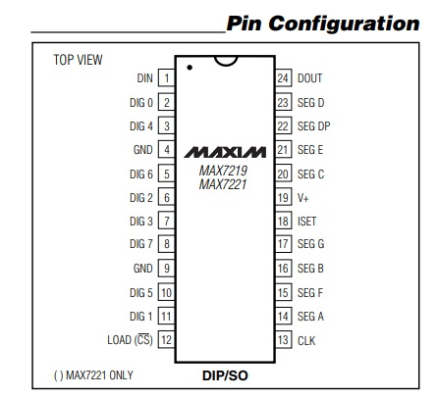
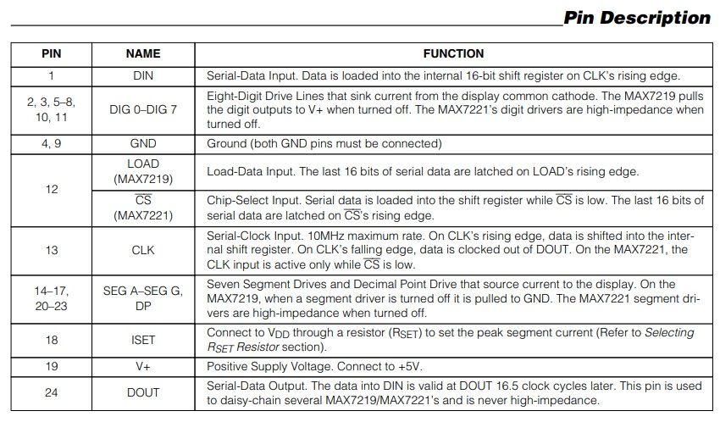
LED MATRIX DRIVER

Slide 28
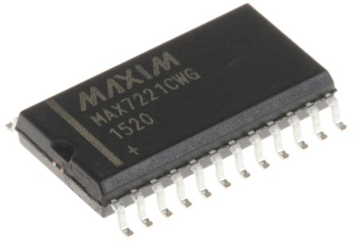
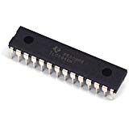
LED MATRIX DRIVER

Slide 29
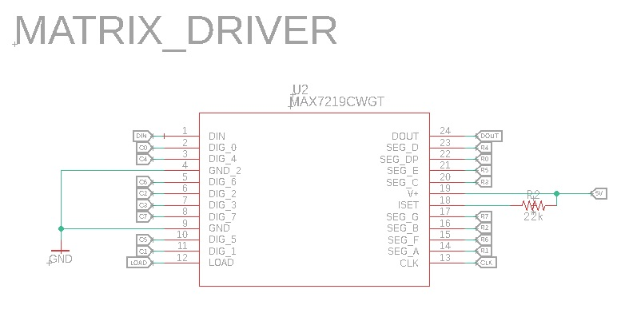
LED MATRIX DRIVER

Slide 30
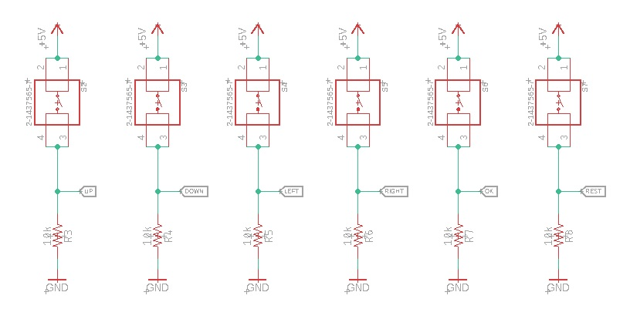
SWITCHES FOR CONTROL

Slide 31
Eagle Schematic Design
Hands – ON

